Slide 1
Storytelling Through Lighting
Notes:
Do not start with the title. Put up the Presto still and ask the question on the next slide first.

Slide 2
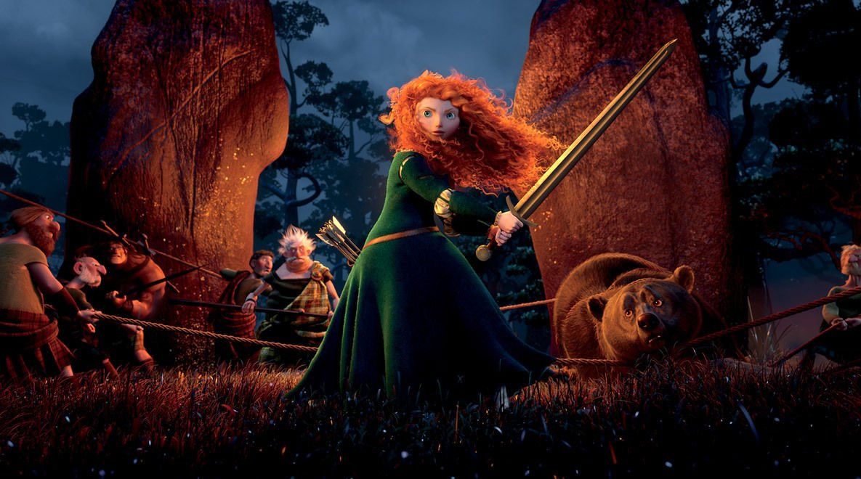
Nothing Is Accidental
Every element in a frame has a purpose
Light is one of the most important of them
You already do this with composition — light is the same argument, different tool
Notes:
Nothing in the frame is accidental. Every element has a purpose and should be considered when telling a story. One of the most important is the treatment of light.
What is the light doing here? Where's it coming from? What time is it, how does it make her read? Let them answer; there's no wrong answer yet.

Slide 3
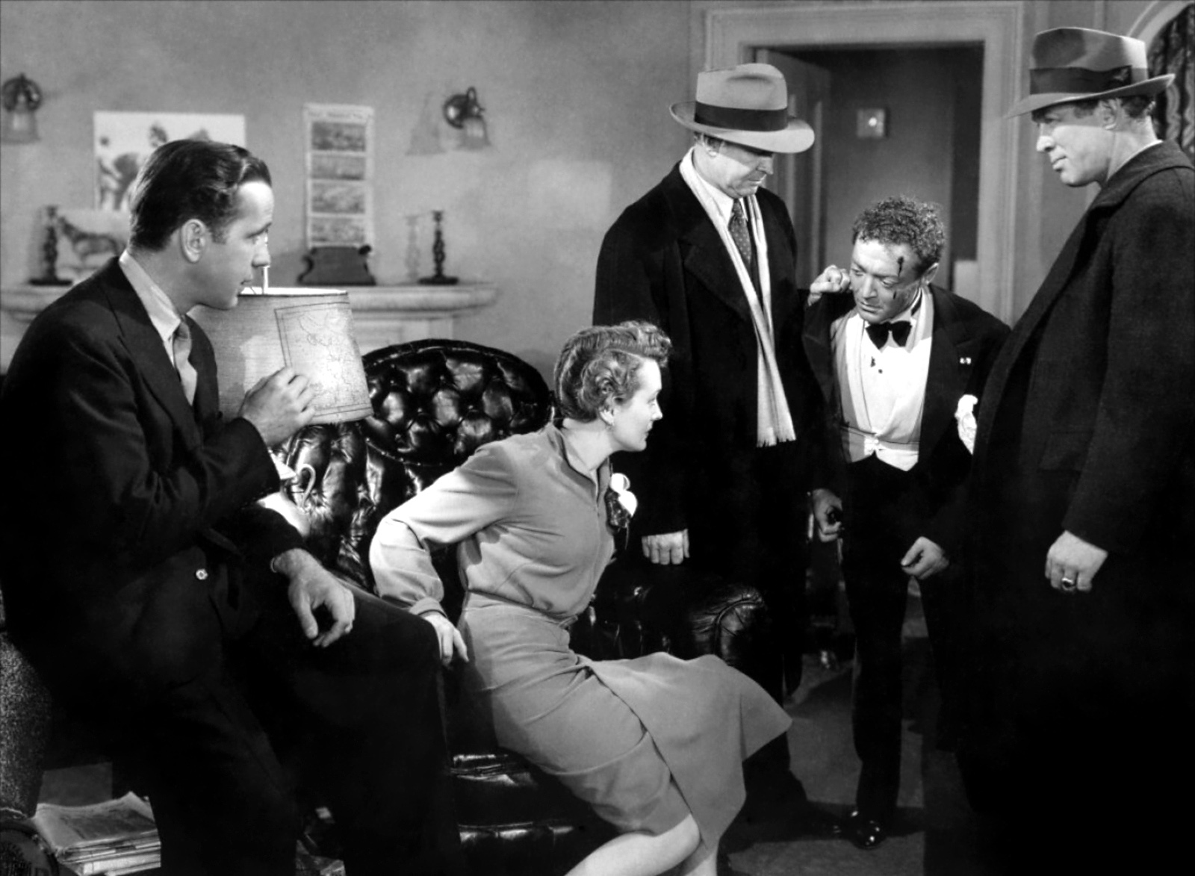
Where This Comes From
Lighting started as a technical necessity - you needed enough light to expose film
Film noir turned it into a storytelling language in the 1930s and 40s
Most of what we use today was worked out back then, and it still holds up
Notes:
In the early days of film, lighting was a necessity for proper exposure. As the technology got better, so did the uses for how light could serve a story. By the 1930s and 40s the lighting style was doing narrative work, not just exposure work.
Most of this vocabulary is eighty or ninety years old and still completely current. That's not nostalgia — they solved these problems early and the solutions held.

Slide 4
Film vs. 3D
Film: physical lights on a set
3D and animation: virtual lights in software, mimicking the same real-world behavior
Either way, you decide the mood before you touch a light
Notes:
Lighting design is one of the biggest artistic challenges in any medium — film, animation, or games. The general principle in animation is the same as live action. Film needs a physical setup; 3D uses virtual lights, and the artist is mimicking real-world lighting behavior in software.
The restraint part matters: don't move a light until you know what mood you're going for. Otherwise you're just pushing sliders.

Slide 5
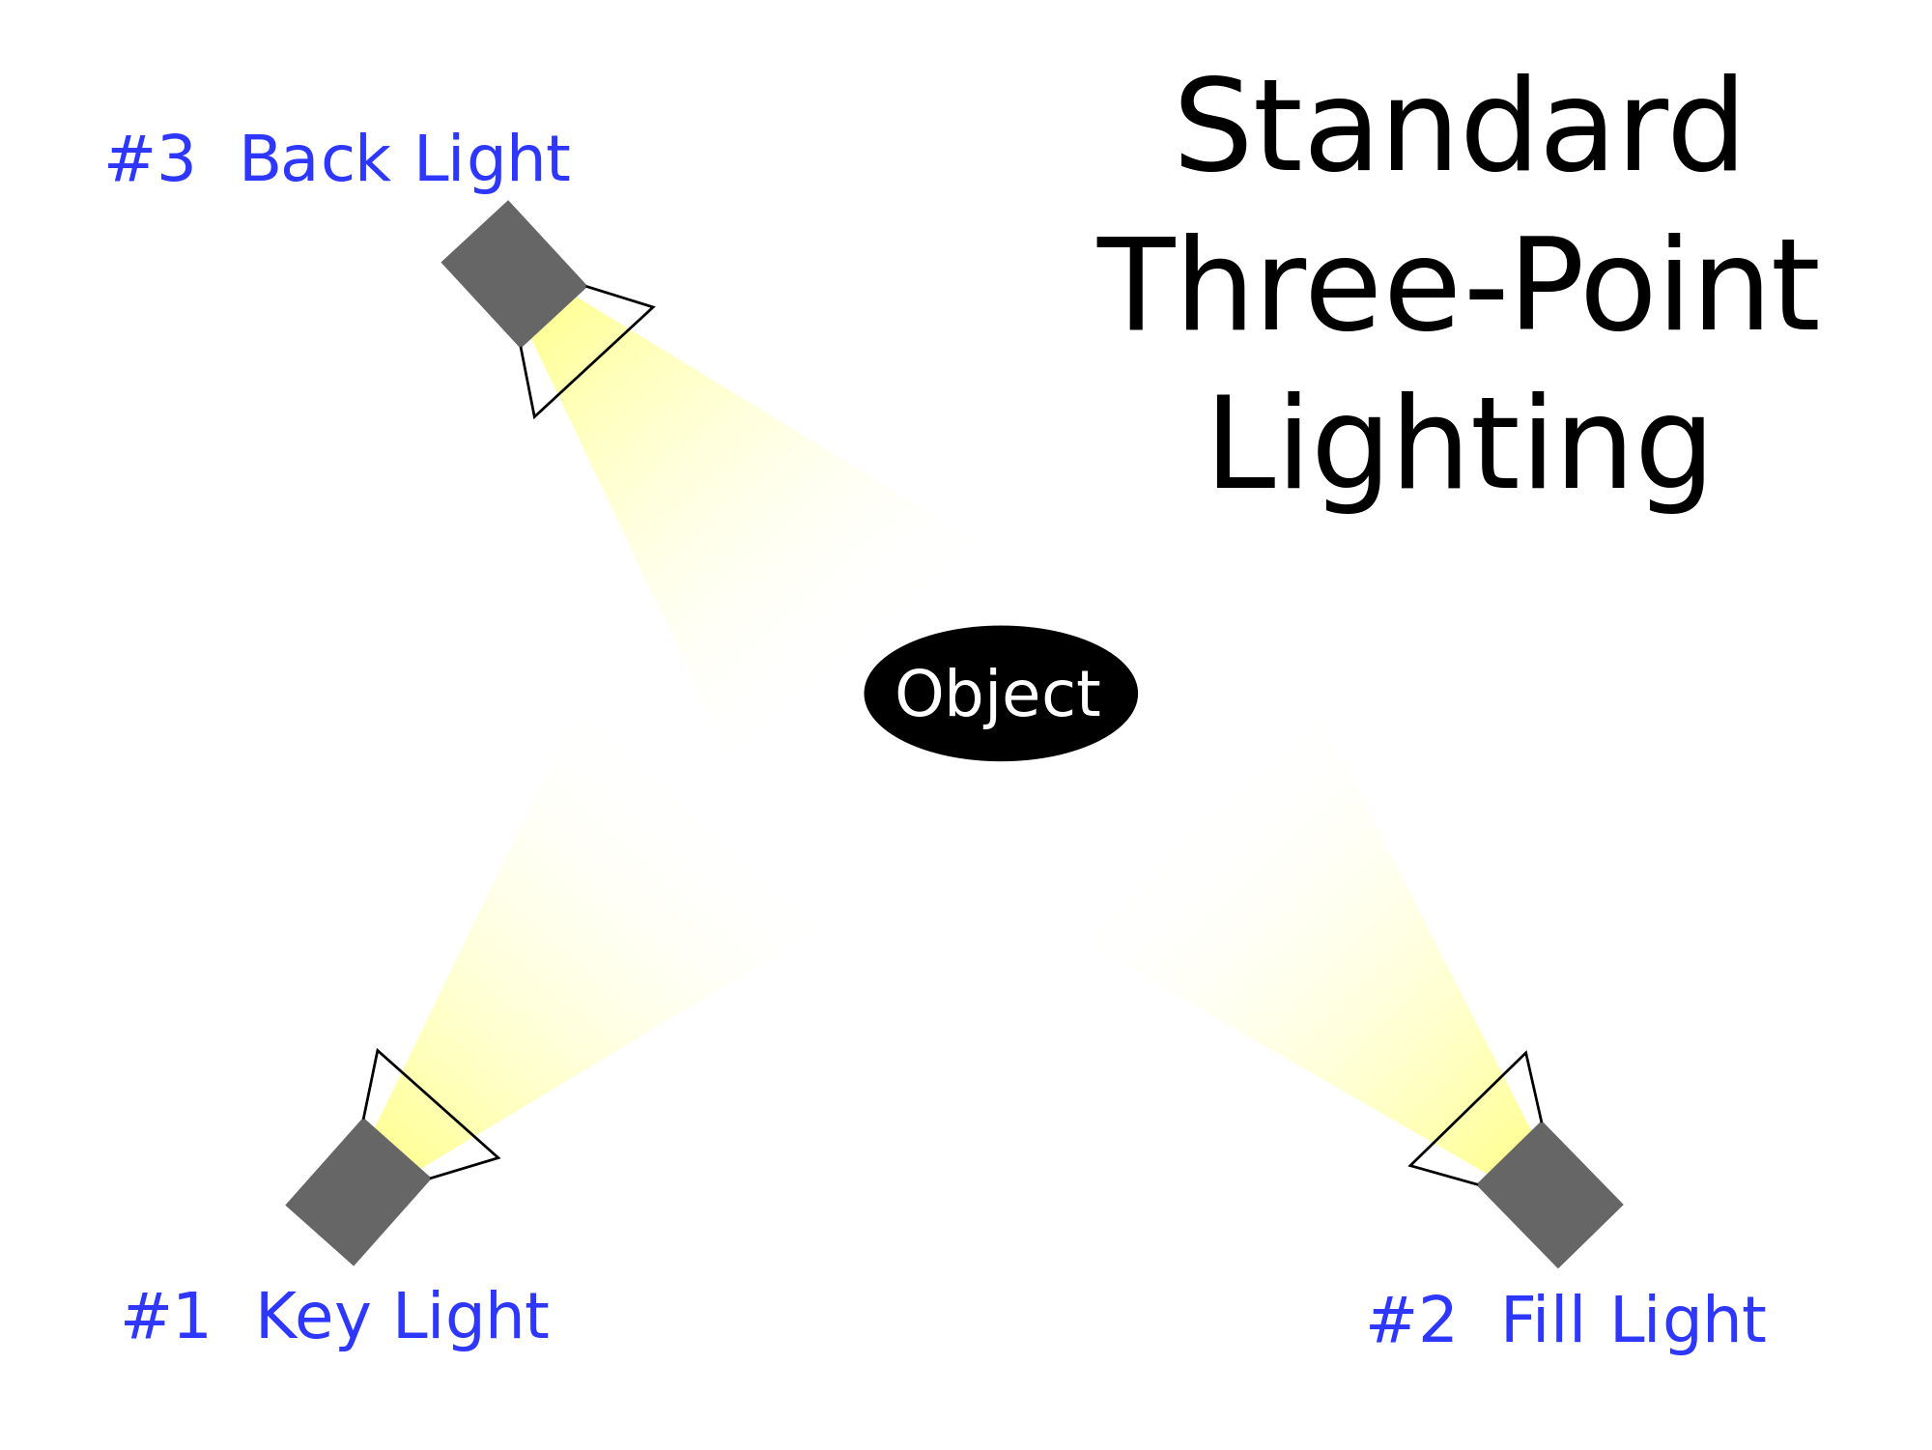
The Standard Setup
Key light · fill light · back light
Became the standard in Hollywood in the 1930s and 40s
Still the default starting point on most productions
Notes:
Three-point lighting became standard during classical Hollywood and continues today as the starting point for most productions. Key, fill, and back — three lights, three different jobs, which is why we'll take them one at a time.
[IMAGE: three-point lighting diagram] Walk the diagram, then go to the next slide where we find all three in an actual frame.

Slide 6
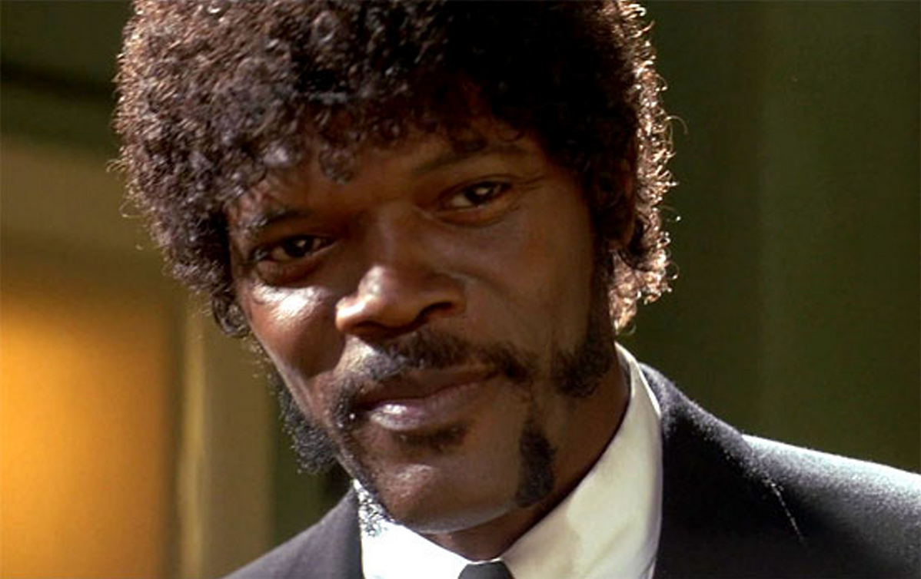
Key Light
The main source — it defines the subject
Usually placed around 45° off to one side of the camera
It creates the shadows, which is what brings out texture and form
Notes:
The key light is the main source that defines the subject. Usually about 45 degrees off one side of the camera. It illuminates the subject and creates the shadows that bring out texture. The sun is a key light — though direct sun produces harsh shadows at certain times of day.
[IMAGE: Pulp Fiction — Jules] This frame is a great three-point example because you can actually see all three lights working. Right now, just find the key: it's coming from camera left, and it's what's carving his face. Ask them to point at it before you do.

Slide 7
Fill Light
Fills in — or softens — the shadows the key created
An indirect, softer source
Lowers the contrast between light and dark
Notes:
The fill light fills in or softens the shadows the key light created. It's an indirect source, and it lowers the contrast between light and dark.
[IMAGE: same Pulp Fiction frame] Same frame. Now find the fill — look at the shadow side of his face. It isn't black. Something is putting a little light back into it, and that something is the fill. Ask them what it would look like with no fill at all, and then show them the Godfather frame later as the answer.

Slide 8
Backlight
Positioned behind the subject
Creates a rim of light that separates the subject from the background
Gives form to hair and clothing that would otherwise disappear
Notes:
Backlight is positioned behind the subject. It creates a highlight around them that lets them stand out from the background, and it gives form to things like hair and clothing that would otherwise fade back.
[IMAGE: same Pulp Fiction frame] Third pass on the same frame. Look at the edge of his hair and the top of his shoulder — that bright line is the back light doing its job.
This is the same separation problem we solved with value contrast in the composition class. Different tool, same job: the figure has to read against the ground.

Slide 9
The Two Families
A subject's look is mostly defined by its key light
Outside that's the sun or the moon. Inside it's a lamp or a window
High-key and low-key are the two basic approaches
Notes:
The appearance of a subject is usually defined by the key light. Outside, that's the sun or moon; inside, a main light or a window. High-key and low-key are the two families of approach, and they're worth being able to name on sight.

Slide 10
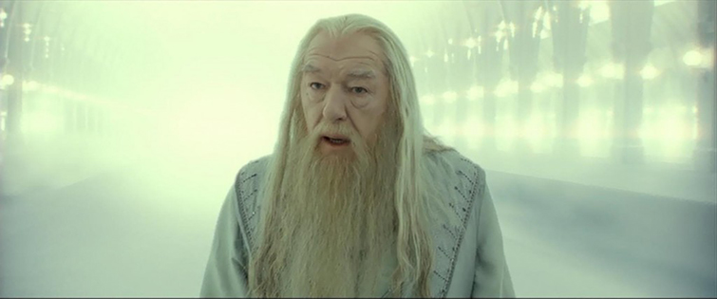
High-Key Lighting
Overall brightness, minimal shadow
Used to simulate daytime, or something beyond daytime
Comedies, upbeat adventure, sitcoms, news, corporate video
Notes:
*** REPLACE IMAGE: swap the Dumbledore frame for GANDALF — Lord of the Rings. That's the example you actually want here. ***
Why Gandalf: he's close to ambiguously divine in Tolkien, and he shows up out of nowhere when characters are in real trouble. Blasting him with high-key, low-contrast light gives him a holy quality without anyone having to say a word about it. Film is subjective and it can be read other ways — but as a choice it's extremely effective, and that's the point worth making.
High-key conveys overall brightness with minimal shadow. It simulates daytime, and it's standard in comedy, upbeat adventure, sitcoms, news, and industrial video. It can also do something less obvious, which is what the Gandalf example is for: too much light, in the right context, reads as transcendent rather than just bright.

Slide 11
Low-Key Lighting
Uneven distribution of light
Lots of shadow, with concentrated pools of light
Large areas left underlit — the film-noir signature
Notes:
Low-key produces an uneven distribution of light: an abundance of shadow, concentrated pools of atmospheric light, and big areas of the frame left underlit and genuinely dark. The best-known low-key productions are film noir.
[ADD IMAGE: a low-key / noir frame — optional, the Godfather frame later covers similar ground]

Slide 12
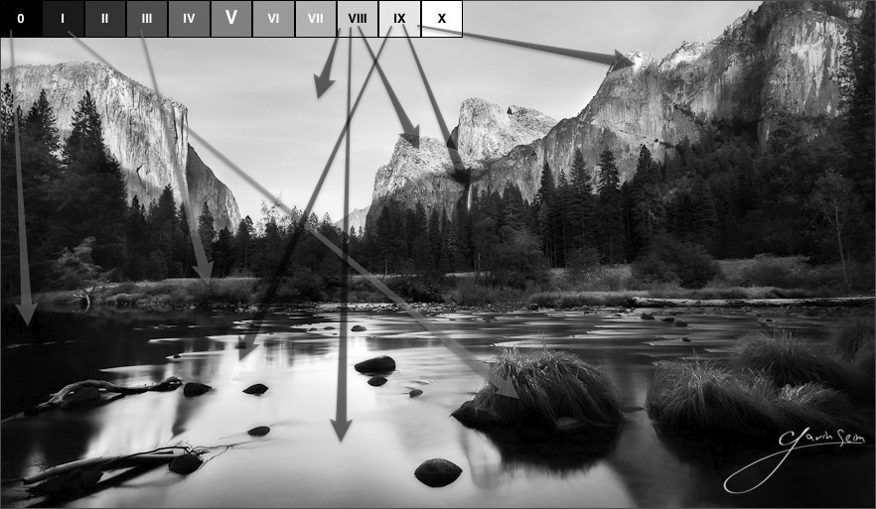
What Contrast Does
The difference between the lightest and darkest parts of a frame
It directs attention — the same job value contrast does inside a single panel
If everything is equally lit, nothing is emphasized
Notes:
Overall contrast is the difference between the lightest and darkest parts of the frame. Using contrast, you focus the viewer's attention on specific areas — where if the whole image is uniformly lit, the focus is on everything, which means nothing.
[IMAGE: Ansel Adams' Zone System] Adams built a whole system around this. You don't need the system, but you should know somebody thought this hard about it.
This is the same instinct from the composition class, applied to a full lighting setup instead of one panel.

Slide 13
High Contrast
Emphasizes the extreme difference between light and dark
Sets one part of the frame hard against another
Thrillers, horror, suspense
Notes:
High-contrast designs emphasize the extreme difference between light and dark, creating dramatic images by setting one part of the frame off against another. Usually seen in thrillers, horror, and suspense.

Slide 14
Low Contrast
No pure whites or blacks — a range of grays
The viewer takes in the whole composition rather than its parts
Risk: reads as flat unless you meant it
Notes:
In a low-contrast setting there are no pure whites or blacks, just a range of grays. The viewer takes in the overall composition rather than its individual parts. Low contrast gets called boring because the images can feel flat — same trap as an evenly rendered storyboard panel where nothing is emphasized. It's only a problem when it's an accident.

Slide 15
Hard vs. Soft, Explained by the Sun
A sunny day: harsh edges and hard shadows — the light is directional
An overcast day: soft, diffuse shadows — the light comes from everywhere
Notes:
To understand the quality of light, go back to the sun as key. A sunny day creates harsh edges and shadows because it's directional. An overcast day is the opposite — soft, diffuse shadows, because the light is arriving from all directions at once. That's the whole concept, and everything else about hard and soft light follows from it.

Slide 16
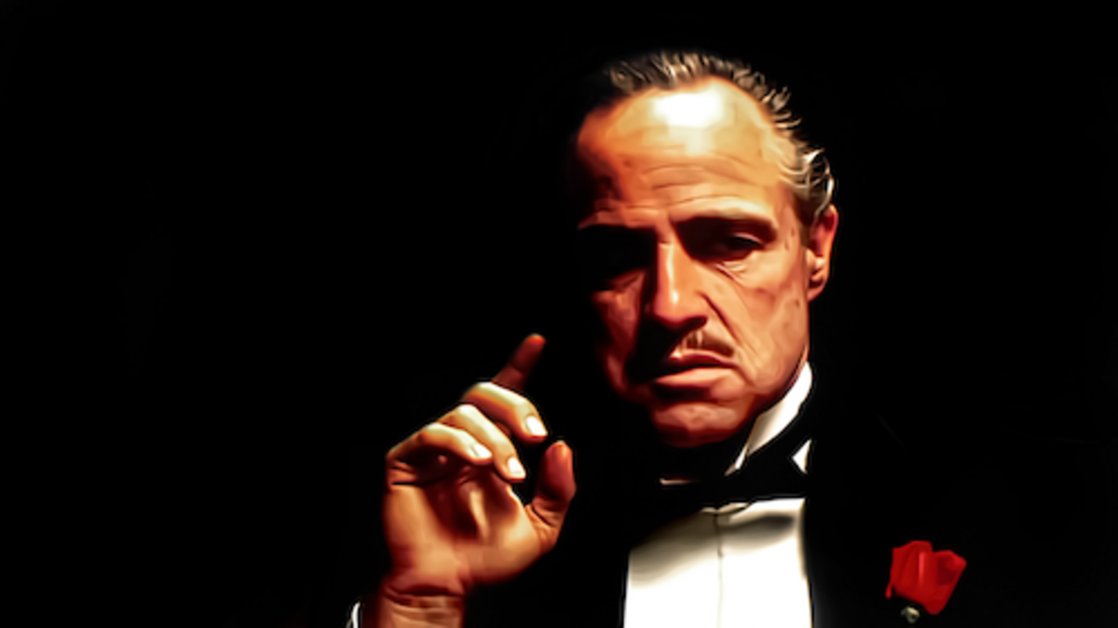
Hard Light
Emphasizes the dramatic
Illuminates everything — texture and imperfections included
Sharp, clearly defined shadow edges
Notes:
Hard light emphasizes the dramatic, often by illuminating a character's imperfections in ways that aren't flattering. It casts clearly defined shadows with sharp edges.
[IMAGE: The Godfather — Brando] This is the fill-light question from earlier, answered. Almost no fill. The eyes go dark. That was a deliberate choice and it's most of why the character reads the way he does.

Slide 17
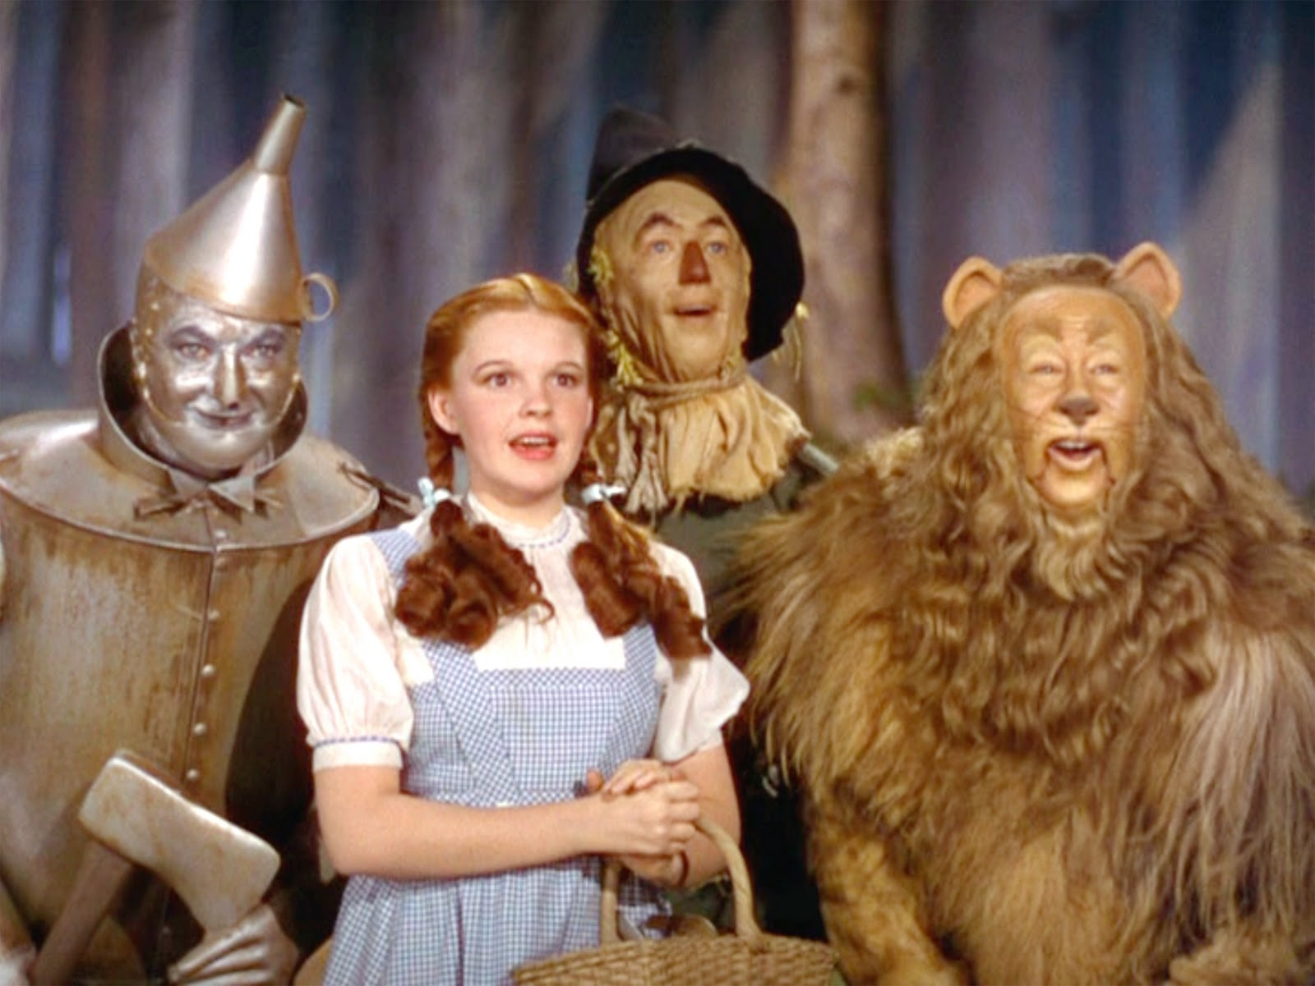
Soft Light
Softens everything it touches
Used since the 1940s to even out skin and hide imperfections
Notes:
Soft light softens the subject. Actresses in the 1940s were routinely shot in soft diffused light because it evens out skin tone and hides wrinkles and blemishes.
[IMAGE: The Wizard of Oz] The choice between hard and soft is partly a choice about how honest the image is willing to be about the face in it.

Slide 18
Drawing Light in a Storyboard Panel
The quality of light you've decided on determines how you draw the shadow
Hard light → sharp-edged shadow shapes
Soft light → soft gradients
Either way it's a decision, not a default
Notes:
This is the slide where all of this becomes storyboarding instead of cinematography. Everything before it was so you could make this decision on purpose.
When you draw a panel, the kind of shadow you draw depends on the quality of light you've chosen. Hard light means harsh, sharp-edged shadow shapes. Soft light means soft gradients. Drawing the hard edge takes confidence; drawing the soft one takes restraint. What matters is that you picked one.

Slide 19
Direction Changes the Mood
Front · side · back · above · below
Same light, five completely different results
Direction is what casts the shadows that reveal texture and detail
Notes:
A light source can come from many directions — side, front, back, below, above. The direction changes the pattern of light and shadow, which changes the mood. It matters because direction is what casts the shadows that emphasize texture and detail. Next five slides, one direction at a time.

Slide 20
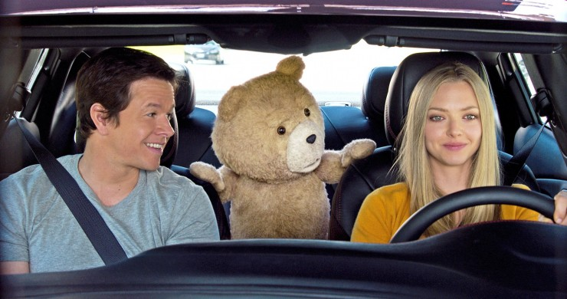
Frontal Lighting
Flat image, little separation between foreground and background
Minimal shadow and texture
Good when you want color relationships read clearly
Notes:
Frontal lighting creates a flat image with barely any separation between foreground and background. Minimal shadow and texture, which on its own tends to be a boring composition — though it's genuinely useful when you want the color relationships read clearly without shadows interfering.
[IMAGE: Ted] Comedy uses this constantly. Bright, flat, nothing hidden — which is exactly right for the genre.

Slide 21
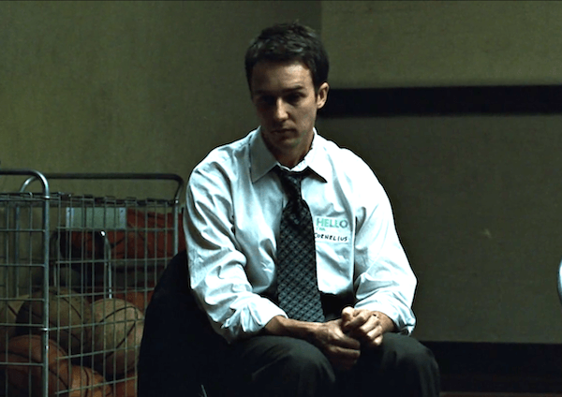
Side Lighting
Strong contrast: one side lit, one side in shadow
Creates a three-dimensional effect through the shadow it casts
Often used for internal conflict — a character half in light, half in dark
Notes:
[IMAGE: Fight Club — the narrator, side-lit]
Strong contrast is created when one side is brightly lit and the other is in shadow. Side lighting creates a three-dimensional effect, and it brings out detail and texture — leaves on a tree, creases in a face.
It's often used to convey a character's internal struggle, staged literally half in light and half in shadow. Fight Club's narrator is the classic case: a straight-cut, buttoned-up insomniac who invents a wild, unhinged version of himself, and the film splits him down the middle visually. Edward Norton is very good at holding both of those at once, which is part of why the lighting choice lands.
If the room doesn't know the film (this happens more than it used to): 20 seconds of setup is enough. They don't need the plot — they need that the lighting is doing character work the dialogue isn't.

Slide 22

Backlighting
The source is behind the subject
Separates background from subject and creates depth
Push it far enough and you get pure silhouette
Notes:
Backlighting is when the source is behind a subject that comes forward in frame. It creates the illusion of depth by separating background from subject — the same edge-definition job the back light does in a three-point setup, now promoted to the dominant light.
[IMAGE: Star Wars — Rey at sunset] Push it far enough and the subject goes to silhouette, which connects straight back to the silhouette standard from the composition class.

Slide 23
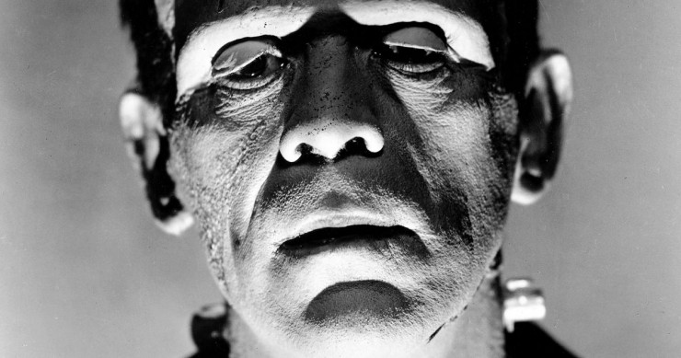
Underlighting
Light from below — produces unnatural shadow patterns
Lights the bottom half of a figure, shades the top
Reads as sinister — a horror and thriller convention
Notes:
Underlighting comes from below and produces odd-looking shadows. It lights the bottom half of a figure and shades the top, which makes a character read as malevolent. Horror and thrillers use it constantly.
[IMAGE: Frankenstein, 1931] Once you know it, you can't un-see it — worth asking the room where else they've noticed this.

Slide 24
Exercise: Light the Same Pose Four Ways
Take one silhouette from your earlier work
Redraw it four times: front, side, back, and from below
Same figure, four different moods — no new drawing skill required
Notes:
This is the whole session in one exercise.
The pose doesn't change. The story does.
Post all four as your exit ticket - graded on the decision, not the rendering.

Slide 25
Train Your Eye
Watch real light — indoors, outdoors, morning versus evening
Photography books are full of people who studied this carefully
It's a habit, not a one-time lesson
Notes:
Look through photography books. Watch the light in different environments, indoors and out, and notice the difference between morning, afternoon, and evening light. Observing it in real situations is what lets you draw it convincingly from imagination later — which is the actual goal.

Slide 26
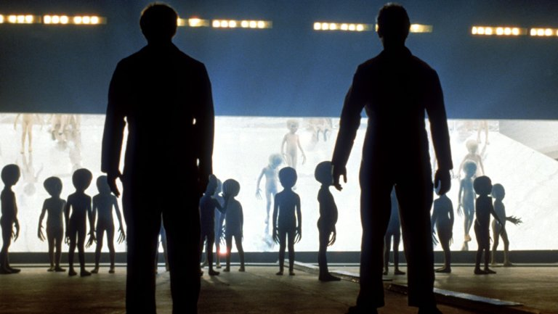
Realistic Lighting
Most productions default here — light that could plausibly exist
Candles and firelight sell a real setting
Games lean on it to make characters feel grounded
Notes:
Most productions aim for scenes that look realistic, suggesting to the audience that the light they're seeing could actually exist in that space. Candles and fireplaces enhance a realistic setting. Games use realistic lighting to make characters feel grounded in their environment.
[IMAGE: Close Encounters]

Slide 27
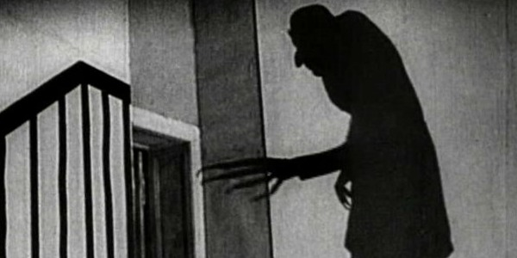
Dramatic / Stylized Lighting
Makes the image more dramatic, on purpose
Roots in early cinema — German Expressionism
Games use it to steer the player's focus
Notes:
A stylistic approach makes the imagery more dramatic. Stylized lighting accentuates mood, and its roots in early cinema are in German Expressionism. Games use it to direct the player's focus toward what matters.
[IMAGE: Nosferatu] The choice between realistic and dramatic is itself a storytelling decision. You are not required to default to realism.

Slide 28
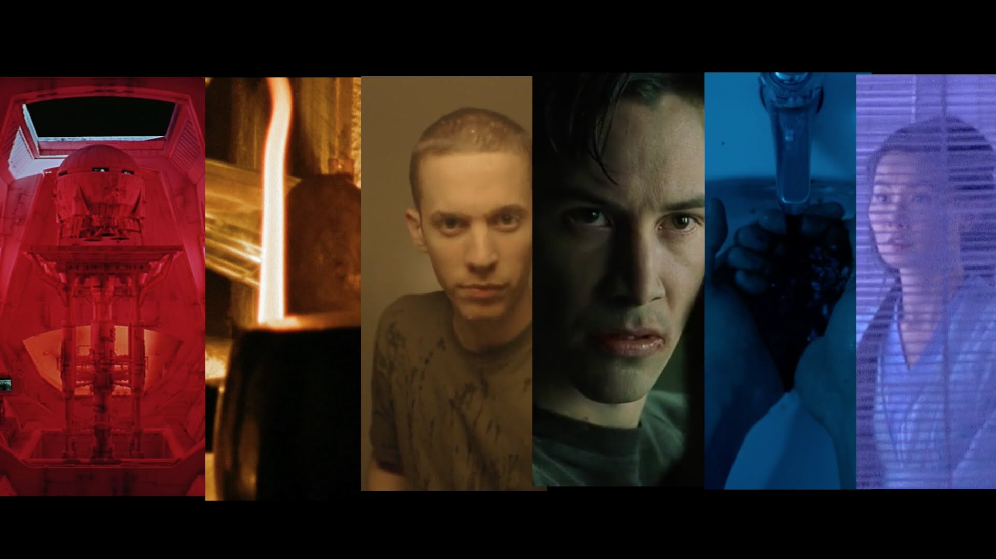
What Color Does in a Story
Establishes time, place, and mood
Reads differently from person to person — partly taste, partly culture
Worth saying out loud before we treat any of it as a rule
Notes:
The color palette plays a big role in the visual style of film, animation, and games. Color creates a sense of time and space, establishes mood and atmosphere, and provides emotional cues.
[IMAGE: color-grading comparison strip] A color that causes one reaction in one person can cause a very different one in someone else — sometimes personal preference, sometimes cultural background. Keep that caveat in view for this whole section.

Slide 29
Contrast Is the Real Tool
Contrast is a tool of emphasis — that's the actual principle
Value contrast, color contrast, sharpness, scale, motion — all the same job
Color is one of many ways to bring attention to something, or take it away
Notes:
This is the part worth getting across, more than any color-wheel vocabulary.
Contrast is a tool of emphasis. That's the principle. Color is just one of many, many ways to get contrast — alongside value, sharpness, scale, density, and motion. All of them do the same job: bring attention to something, or take attention off something.
So the question in front of a panel is never 'what colors go together.' It's 'what am I emphasizing, and what's the cheapest way to emphasize it.' Sometimes that's color. Often it isn't.

Slide 30
Making Something Stand Out — Or Getting Out of Its Way
The obvious move: make the character brighter, more saturated, higher contrast
The better move, often: lower the contrast of everything else
Analogous background + contrasting character is a workhorse in games and film
You can subtract attention as easily as you can add it
Notes:
Here's a move worth knowing, because it changes how students approach this.
When you want a character to stand out, the instinct is always to make the character brighter, more saturated, more contrasty. That works, sometimes. But often the better move is the opposite: leave the character alone and lower the contrast of the background.
Keep the background analogous — colors sitting next to each other on the wheel, close in value — and then put the character in something that contrasts with that. The character pops without you having to do anything to the character at all. Games do this constantly, because they have to guarantee you can find the player and the objective. Film does it too.
The general lesson: you can subtract attention as easily as you can add it. Usually subtracting is cheaper and looks better.

Slide 31
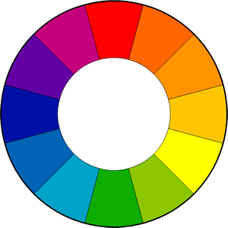
The Wheel, Once
Primary · secondary · tertiary, on the standard 12-color wheel
Opposite on the wheel = contrast, tension, energy
Adjacent on the wheel = analogous, harmony, calm
You can look up the rest when a job calls for it
Notes:
[IMAGE: 12-color wheel]
Here's the wheel, once, as reference. The most common version is twelve colors based on the RYB model.
You don't need to memorize scheme names — triadic, split-complementary, tetradic. What you need is that opposite colors create contrast and tension, and adjacent colors create harmony. Those two facts do almost all the work, and they're what the previous slide was built on. Everything else you can look up the day a job calls for it.

Slide 32
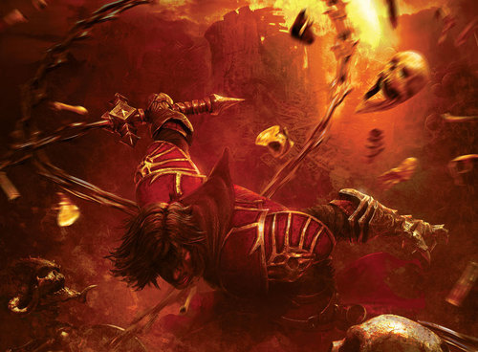
Warm
Red, orange, yellow
Fire, sunsets, heat — energy, passion, aggression, urgency
Consistent with what the character is doing, not just decoration
Notes:
[IMAGE: Castlevania: Lords of Shadow — Gabriel]
Warm colors are red, orange, yellow and their variations. Fire, autumn leaves, sunsets. They generally read as energizing, passionate, urgent, sometimes angry.
This frame is a good one: Gabriel mid-slaughter in a yellowish, infernal environment. The red and yellow are carrying his rage, and that's consistent with both the gameplay and his backstory — he's a genuinely interesting character and the palette is doing part of that characterization. It isn't decoration; it agrees with what he is.

Slide 33
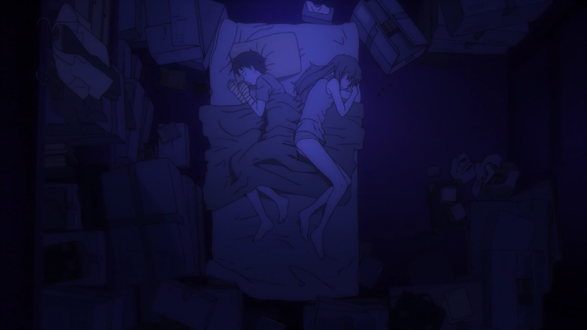
Cool
Blue, green, purple
Night, water, distance — calm, reserved, isolated, heavy
Yes, this is a cliché. It's also load-bearing when it's used well.
Notes:
[IMAGE: Evangelion]
Cool colors — green, blue, purple — are usually more subdued. Night, water, nature. Calming and reserved, and often reading as sad or isolated.
Evangelion is worth putting up precisely because it's an anime about kids that is heavy and depressing and deals with genuinely difficult material. The cool palette accentuates that weight constantly — you feel it before you can explain it.
Say this part honestly: warm-equals-energetic and cool-equals-sad is a cliché. But it's a cliché because it works, and the interesting conversation isn't whether it's true — it's what you can do with it once you know the audience already reads it that way. That's a good place to let the room argue.

Slide 34
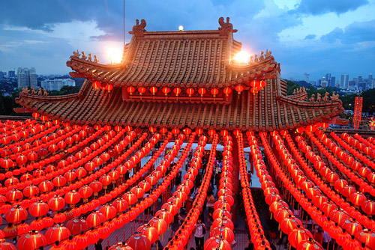
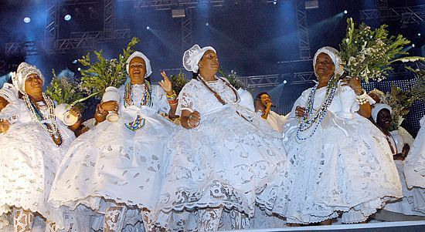
Color Meaning Is Cultural
Color carries real connotation — but connotation is not universal
Red: danger and passion in one place, luck and celebration in another
White: weddings in one culture, mourning or ceremony in another
Know your audience, then decide
Notes:
[IMAGES: red lanterns / white ceremonial dress]
Color carries real connotation. But none of it is universal, and this is where the caveat from the start of the section pays off.
Red reads as danger and passion in a lot of Western media, and as luck, prosperity, and celebration elsewhere. White reads as purity and weddings in some places, and as mourning or ceremonial dress in others. Genre convention shifts it too — red in horror is not red in a romance.
Use these associations as the starting point for a decision, not as a rule you're obligated to follow. And know who you're making it for.

Slide 35
Apply It: Light and Color, One Panel
Take a panel from your current sequence
Pick a light direction and quality, on purpose
Pick a color temperature, on purpose
Be ready to say why in one sentence
Notes:
Bring one panel to critique where the lighting and color were decided rather than defaulted. One sentence on why is all I want — that sentence is the actual skill this session was building toward.
If you can't say why, that's useful information too, and it's a fine thing to say out loud.

Slide 36
A Language Still Being Written
Cinema took about a century to make this language fluent
Audiences now read it without noticing they're reading it
Games are building their own version of it right now, in public
You're learning fundamentals while that's still happening
Notes:
Lighting as storytelling took roughly a century of cinema to become something audiences read fluently without noticing. Games are visibly doing the same thing right now — building a visual grammar in real time, while you're a student, instead of long before you got here.
Say this plainly: when I was in school, games weren't taken seriously in a room like this one. That was wrong then and it's clearly wrong now. The medium is established, or close enough that betting against it is the outdated position.
You're learning the fundamentals of a language during the part of its history where it's still being actively written. That's rare, and it's worth knowing while it's happening to you.
Good place to open the floor — if anyone wants to argue about where this goes next, that's a better use of the last ten minutes than anything else on this slide.

